Slide 1
Faster Convergence in
Gradient Descent
Using Multithreading
Pratham Loya
201080068
Batch D

Slide 2
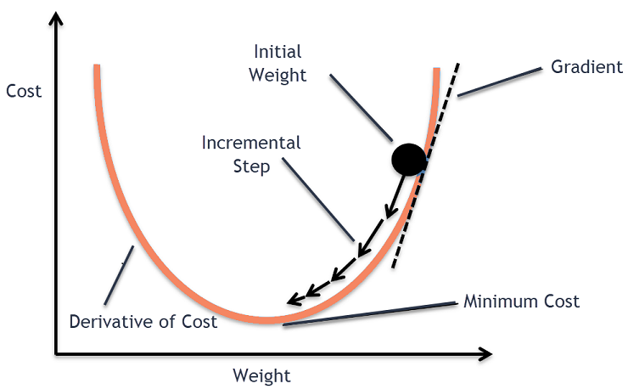
Gradient Descent
Gradient descent is an optimization algorithm commonly used in machine learning to minimize a cost function (also known as an objective or loss function).
The basic idea behind gradient descent is to iteratively adjust the parameters of a model in the direction of steepest descent of the cost function.
Gradient descent is a way to find the best possible values of the parameters of a model, such as the weights of a neural network or the coefficients of a linear regression model, by iteratively adjusting them in the direction of the negative gradient of the cost function.

Slide 3
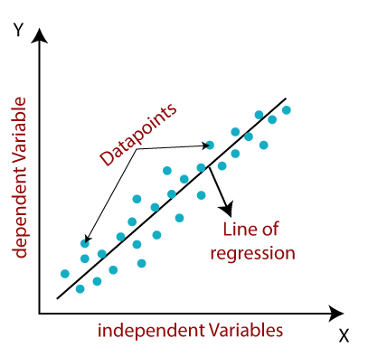
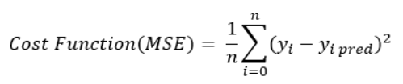
Linear Regression
Linear regression is a statistical method used to model the relationship between a dependent variable and one or more independent variables. The goal of linear regression is to find the best-fit line or hyperplane that represents the relationship between the variables.
Finding the best-fit line or hyperplane is by using gradient descent. The error or cost function measures the difference between the predicted values of the dependent variable and the actual values.
In gradient descent, the algorithm starts with an initial guess for the parameters of the best-fit line or hyperplane. Then, it iteratively updates the parameters by computing the gradient of the error or cost function with respect to the parameters and moving in the direction of the steepest descent.
The learning rate is a hyperparameter that determines the step size in each iteration. If the learning rate is too small, the algorithm may take a long time to converge. If the learning rate is too large, the algorithm may overshoot the minimum and fail to converge.
By repeating the iterations until the error or cost function is minimized, gradient descent finds the parameters of the best-fit line or hyperplane that represents the relationship between the variables in linear regression.

Slide 4
Problem Statement
“Computation of gradient descent can be time-consuming, leading to slow convergence rates. To speed up the convergence process, we propose using multithreading to parallelize the computation of gradient descent.”

Slide 5
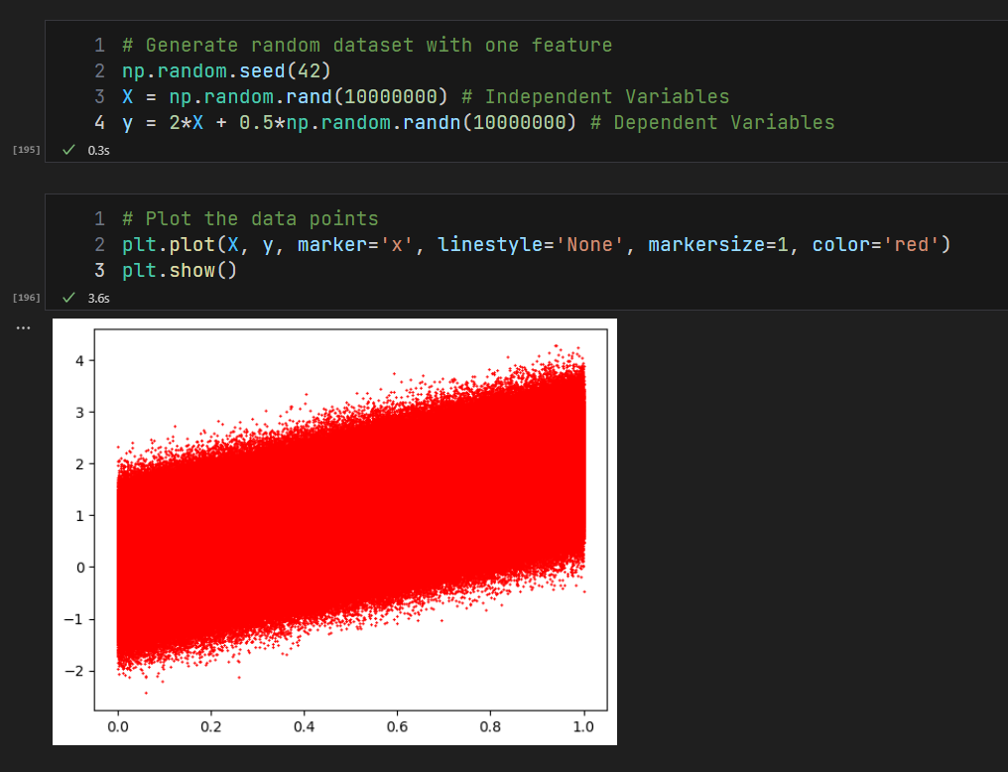
Dataset

Slide 6
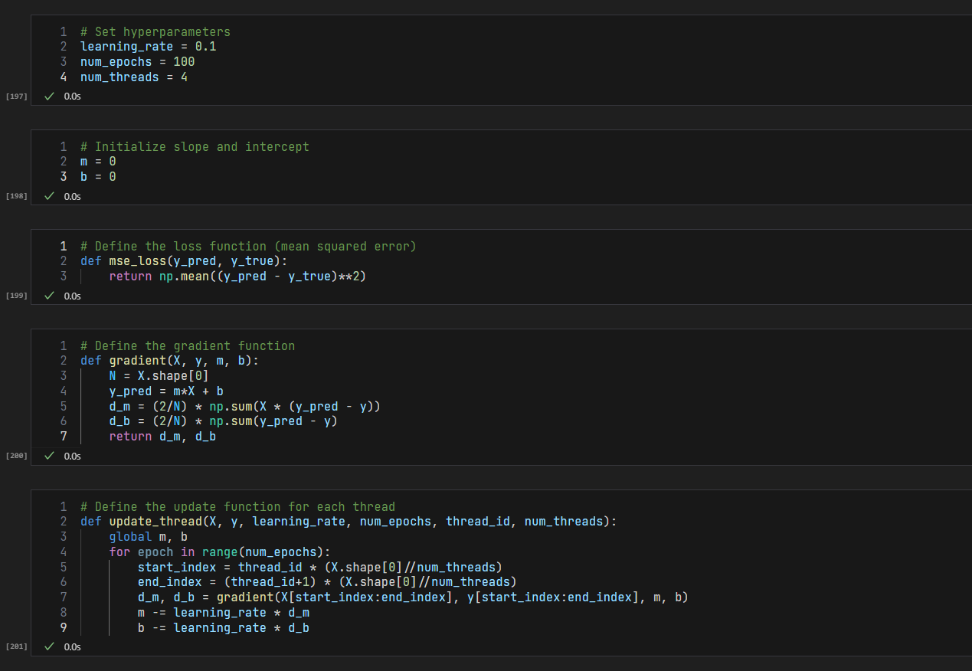
Code

Slide 7
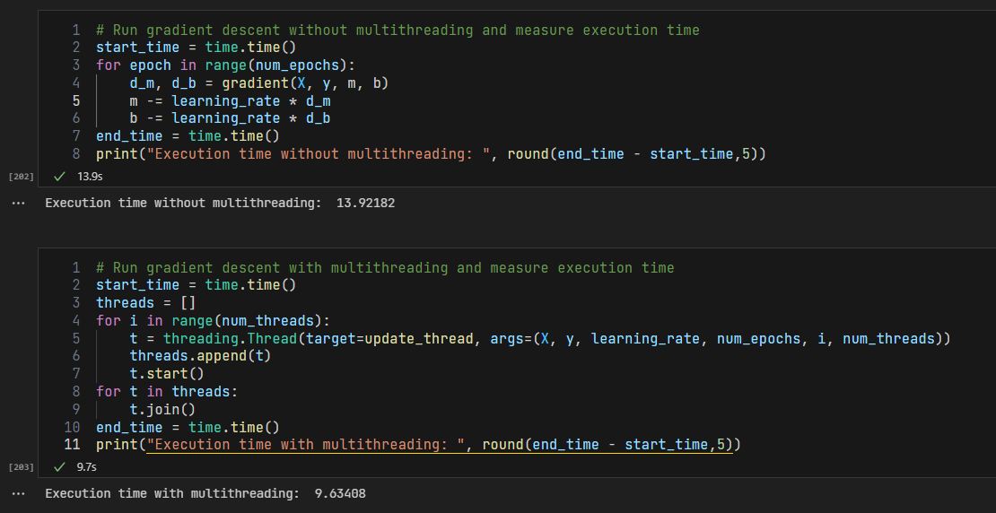
Comparison

Slide 8
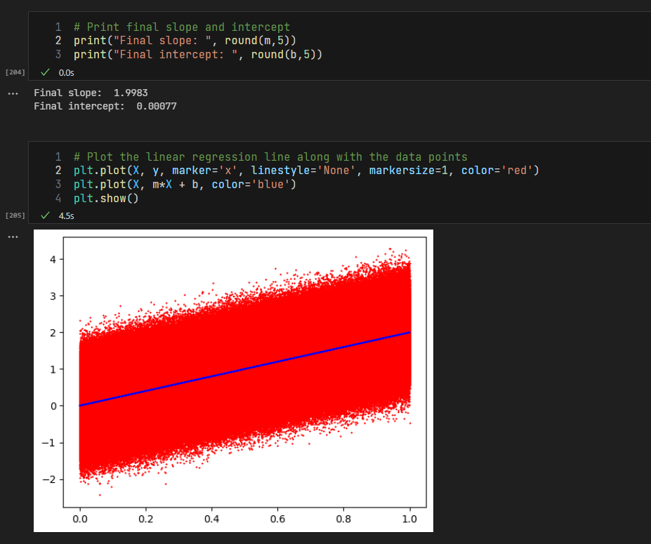
Results

Slide 9
Conclusion
“Comparison between parallel and serial approach showed that the multithreaded approach converged faster, providing a significant speedup in execution time without compromising the accuracy of the model.”

Slide 10
Thank You

